Slide 1
Concurrency in Python

Slide 2
Multithreading vs Multiprocessing

Slide 3
GIL (Global Interpreter Lock)

Slide 4
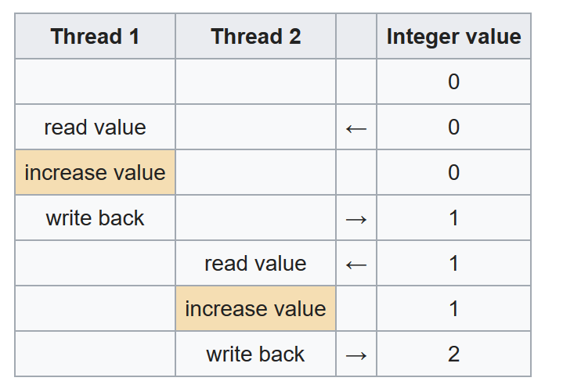

Slide 5
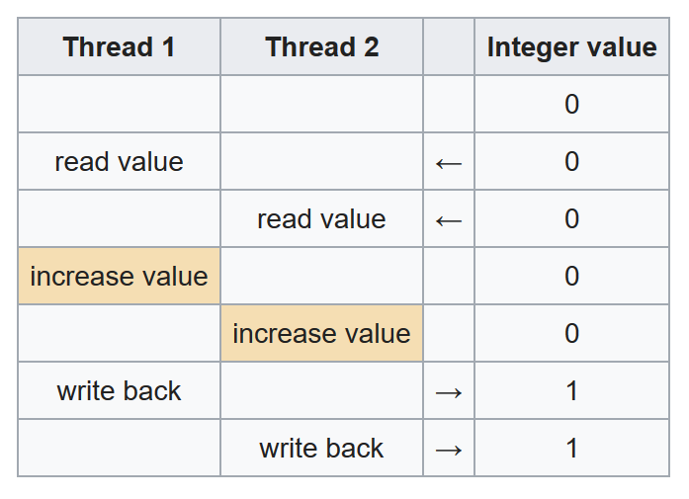

Slide 6
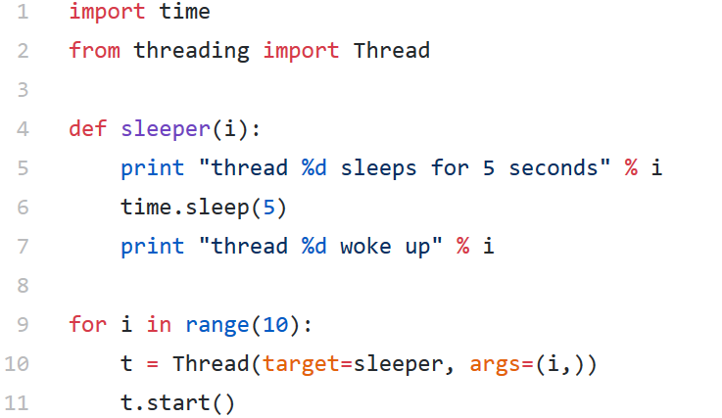
Multithreading

Slide 7
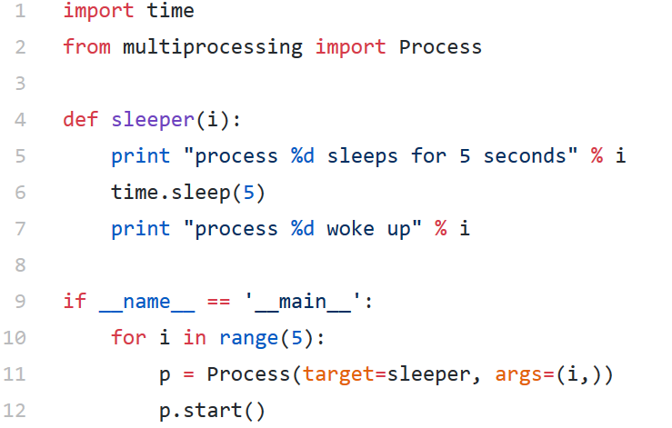
Multiprocessing

